Slide 1
File Handling

Slide 2
You will be dealing with three types of files: text, binary, and pickled objects
Three steps are required for working with files:
Opening a file
Performing actions on the file (reading, writing, updating contents)
Closing the file

Slide 3
Opening a File
The syntax for opening a file is this:
open(file_name, mode)
file_name represents the name of the file, and mode specifies the purpose for opening the file.
The open() method returns a file handler that represents the file on the disk drive.
The file handler can also be positioned at desired byte locations in the file to read or write specific contents from the file.

Slide 4
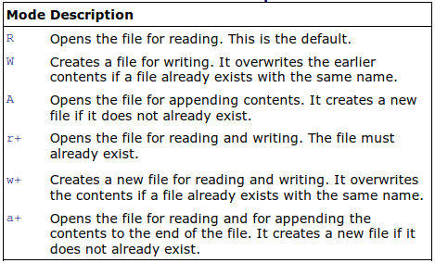
Mode options

Slide 5
For example:
f = open('xyz.txt', 'w')
This creates the file xyz.txt in write mode and returns the file handler to variable f.
Any earlier content in xyz.txt will be erased.

Slide 6
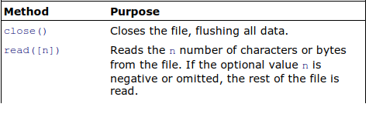
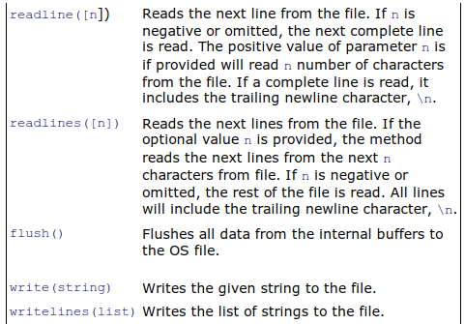
Performing Actions on a File

Slide 7
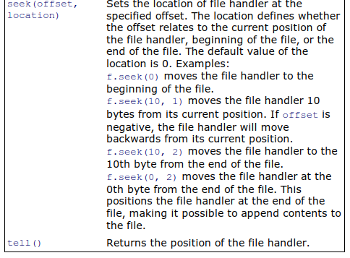

Slide 8
The following program creates a file named aboutbook.txt and writes a couple of lines in it.
The text written in the file is then accessed and displayed on the screen.
createfile1.py
matter = '''Python is a great language
Easy to understand and learn
Supports Object Oriented Programming
Also used in web development '''
f = open('aboutbook.txt', 'w')
f.write(matter)
f.close()
f = open('aboutbook.txt')
while True:
line = f.readline()
if len(line) == 0:
break
print (line,)
f.close()

Slide 9
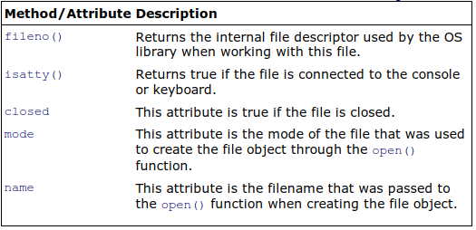
Displaying Information from a File Object
Methods and attributes of a file object

Slide 10
Following is a program that displays the attributes of a file object:
fileattrib.py
f = open("aboutbook.txt", "r")
print ("Name of the file:", f.name)
print ("Closed?", f.closed)
print ("Opening mode:", f.mode)
print ("File number descriptor is:", f.fileno())
f.close()
Output:
Name of the file: aboutbook.txt
Closed? False
Opening mode: r
File number descriptor is: 3

Slide 11
Reading from a File
In the program createfile1.py you used readLine() in a loop to access one line at a time from the file to display on the screen.
The following program shows how to read the entire contents of the file.
fileread.py
f = open('aboutbook.txt', 'r')
lines = f.read()
print (lines)
f.close()
Output:
Python is a great language
Easy to understand and learn
Supports Object Oriented Programming
Also used in web development

Slide 12
Python displays a technical error message when it tries to open a file that doesn’t exist
The error message is displayed through the default Python error handler.
You can make the error message more readable through exception handling.
filereadtry.py
import sys
try:
f = open('aboutbook.txt', 'r')
lines = f.read()
except IOError:
print ('File aboutbook.txt does not exist')
sys.exit(1)
f.close()
print (lines)

Slide 13
Appending Content to a File
The following program shows how to append content to a file:
fileappend.py
import sys
matter2 = ''' Its very hot today
Lets have a Cold drink '''
f = open('aboutbook.txt', 'a' )
f.write("\n%s" %matter2)
f.close()
f = open('aboutbook.txt', 'r' )
lines = f.readlines()
f.close()
print('The contents in the file are:')
for line in lines:
sys.stdout.write(line)

Slide 14
Copying a File
The following program shows how to make a copy of the file aboutbook.txt and name it copyaboutbook.txt:
filecopy.py
f = open('aboutbook.txt', 'r')
lines = f.read()
f.close()
g = open('copyaboutbook.txt', 'w' )
g.write(lines)
g.close()
print('The copy of the file is made')
g = open('copyaboutbook.txt', 'r' )
lines = g.read()
print (lines)
g.close()

Slide 15
Deleting Content from a File
delfilecontent.py
import sys
f = open('aboutbook.txt', 'r' )
lines = f.readlines()
print('Original content of the file:')
for line in lines:
sys.stdout.write(line)
f.close()
del lines[1:3]
f = open('aboutbook.txt', 'w' )
f.writelines(lines)
f.close()
print('\nThe content of the file after deleting second and third line:')
f = open('aboutbook.txt', 'r' )
lines = f.read()
print (lines)
f.close()

Slide 16
Updating the Content of a File
updatefilecont.py
import sys
f = open('aboutbook.txt', 'r')
lines = f.readlines()
print('Original content of the file:')
for line in lines:
sys.stdout.write(line)
f.close()
n=int(input ("\n\nEnter the line number to change: "))
if n <=len(lines):
r=input("Enter the new content: ")
lines[n-1]=r+"\n"
f = open('aboutbook.txt', 'w' )
f.writelines(lines)
f.close()
print('The content of the file after updating line' , n)
f = open('aboutbook.txt', 'r' )
lines = f.read()
print (lines)
f.close()
else:
print ("The line number", n, "is not found in the file" )

Slide 17
Reading the Content of a File Randomly
filerandomread.py
f = open('aboutbook.txt', 'r')
line=f.readline()
print('A line from file is:', line)
f.seek(5)
line=f.readline()
print('The line from character 6 till end of line is:', line)
print ('The pointer is at location', f.tell())
f.seek(10)
line=f.read(15)
print ('The fifteen characters starting at location 11 are as:', line)

Slide 18
Accessing Specific Content in a File
fileanyline.py
import linecache
line=linecache.getline('aboutbook.txt', 3)
print ('The content of the third line is:', line)
This assumes that aboutbook.txt has the following contents:
Python is a great language
Easy to understand and learn
Supports Object Oriented Programming
Also used in web development

Slide 19
Now let’s see how to create a numerical file.
The following program creates a file and stores numbers in it:
filenumerical.py
f = open('numbers.txt', 'w' )
n=int(input('How many numbers? ' ))
print('Enter', n, 'numbers' )
for i in range(0,n):
m=input()
f.write("%s\n" %m)
f.close()
f = open('numbers.txt')
lines = f.readlines()
f.close()
print('The numbers stored in the file are')
for line in lines:
print (int(line),)
print('The numbers in the file multiplied by 2')
for line in lines:
print (int(line)*2,)

Slide 20
Creating a Binary File
binaryfile1.py
str = 'Hello World!'
f = open("filebinary.bin","wb" )
f.write(str.encode('utf-8'))
f.close()
f = open("filebinary.bin","rb" )
fcontent=f.read()
f.close()
print('The content in the file is:')
print (fcontent.decode('utf-8'))

Slide 21
Serialization (Pickling)
Serialization (also known as pickling) is a process of converting structured data into data stream format.
Through serialization, structures such as lists, tuples, functions, and classes are preserved using ASCII characters between data values.
Serialization is done when storing data, and deserialization is done when retrieving data.
For pickling, you can use either module, Pickle or cPickle.

Slide 22
The following program uses the Pickle module to store an instance into a file:
pickleprog.py
import pickle
class rect:
def __init__(self, x,y):
self.l = x
self.b = y
def rectarea(self):
return "Area of rectangle is", self.l * self.b
r=rect(5,8)
f = open('studentinfo.bin', 'wb')
pickle.dump(r, f)
f.close()
del r
f = open('studentinfo.bin','rb')
storedobj = pickle.load(f)
print (storedobj.rectarea())

Slide 23
An instance r of class rect is created, and its instance variables, l and b, are initialized to 5 and 8.
A binary file, studentinfo.bin, is opened in write mode, and r is pickled and dumped into it.
The file is then closed.
r is deleted after it is copied into the binary file.
To read r from the file and set it back into useable form, the file is opened in read mode, and the instance is read from the file with pickle.load(), unpickled, and assigned to storedobj.
The area of the rectangle is calculated and displayed by calling rectarea() on the storedobj object.

Slide 24
The following program stores information by pickling an instance of the user class.
Also, the program unpickles the instances to display the stored information.
pickleprog2.py
import pickle
class user:
def __init__(self, x,y,z):
self.id = x
self.name = y
self.emailadd=z
def dispuser(self):
print('User ID:', self.id)
print('User Name:', self.name)
print('Email Address:', self.emailadd)
f = open('UsersInfo.bin', 'wb')
n=int(input('How many users? ' ))
print('Enter', n, 'numbers')
for i in range(0,n):
u=input('User ID: ')
n=input('User Name: ')
e=input('Email Address: ')
usrobj=user(u,n,e)
pickle.dump(usrobj,f)

Slide 25
f.close()
print('\nInformation of the users is:')
f = open('UsersInfo.bin','rb')
while True:
try:
usrobj = pickle.load(f)
except EOFError:
break
else:
usrobj.dispuser()
f.close()

Slide 26
Exception Handling
Exceptions occur when certain situations arise in a program.
To handle exceptions, you write the code in a block that begins with the word try.
There are two kinds of try blocks:
try/except: The code that might raise an error is written in the try block, and all the errors and exceptions are handled through the except clause.
try/finally: The code written in the finally block always executes whether an exception occurs or not. That is, the code that you want to execute in all situations is written in a finally block.

Slide 27
Using a try/except Block
For handling exceptions through a try/except block, you specify the code that might result in an exception along with a group of except clauses.
Syntax:
try:
statement(s)
except SomeException:
code for handling exception
[else:
statement(s)]

Slide 28
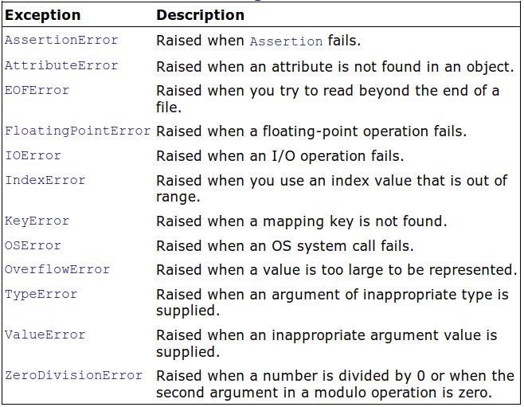
You can have an unlimited number of except clauses in a single try block.
You can nest try blocks

Slide 29
The following program demonstrates occurrence and handling of an EOFError exception
try1.py
import sys
try:
n = input('Enter your name ')
except EOFError:
print ('EOF error has occurred' )
sys.exit(1)
except:
print ('Some error has occurred' )
print ('The name entered is', n)

Slide 30
You can rewrite the above program by using the else clause in the try/except block.
tryelse.py
import sys
try:
n = input('Enter your name ')
except EOFError:
print ('EOF error has occurred' )
sys.exit(1)
except:
print ('Some error has occurred' )
else:
print('The name entered is', n)

Slide 31
The following program demonstrates how TypeError and ZeroDivisionError exceptions occur and how they are handled.
Remember that a TypeError exception occurs when an argument of inappropriate type is supplied, and a ZeroDivisionError exception occurs when a number is divided by 0.
try2.py
from __future__ import division
import sys
n = input('Enter a number ')
if n.isdigit():
n=int(n)
try:
m=15/n
except TypeError as ex:
print ('You have not entered a numeric value:', ex)
sys.exit(1)
except ZeroDivisionError as ex:
print ('You have entered zero value:', ex)
sys.exit(1)
print ('The result is', m)

Slide 32
Using a try/finally Block
The following program demonstrates using the finally block to execute the statements that you want to execute whether an exception occurs or not:
filetryfinal.py
import sys
try:
f = open('aboutbook.txt', 'r')
try:
lines = f.read()
finally:
f.close()
except IOError:
print ('File aboutbook.txt does not exist')
sys.exit(1)
print (lines)

Slide 33
Raising an Exception
Exceptions are automatically raised when some undesired situation occurs during program execution.
You can raise an exception explicitly through the raise statement in a try/except block.
Syntax:
raise customException, statement for customException

Slide 34
When raising an exception in a try block, the format will be this:
try:
if condition:
raise customException, statement for customException
except customException, e:
statements for customException

Slide 35
The following program demonstrates how to create and raise an exception:
raiseexcepclass.py
class myException(Exception):
def __init__(self, quantity):
Exception.__init__(self)
self.quantity = quantity
try:
s = int(input('Enter quantity '))
if s <=0 :
raise myException(s)
except EOFError:
print ('You pressed EOF ')
except myException as ex:
print ('myException: The quantity entered is %d,
it must be some positive value' %ex.quantity)
else:
print ('No exception raised.')

Slide 36
The assert Statement
The assert statement is used to place an error-checking statement in the program.
It is a convenient way to debug a program.
The assert statement returns true if all the values of the variables are as expected, no matter what inputs are provided.
If something is wrong in the program, the assert statement returns false.
The AssertionError exception is raised when the assert statement returns false.

Slide 37
assertex.py
n=int(input('Enter a positive value: '))
assert(n >=0), "Entered value is not a positive value"
Output:
Enter a positive value: -5
Traceback (most recent call last):
File "D:\python\assertex.py", line 2, in >module>
assert(n >=0), "Entered value is not a positive value"
AssertionError: Entered value is not a positive value
Enter a positive value: 5

